Slide 1
The Project on
AI in Agriculture (Disease detection)

Slide 2
Introduction
AI in agriculture involves the use of advanced technologies, such as machine learning, computer vision, and robotics, to improve farming practices and increase crop yields.
AI-based disease detection systems typically involve the use of machine learning algorithms to analyze images of plants and identify signs of disease. These algorithms are trained on large datasets of images that have been annotated with information about the type of disease present, the severity of the symptoms, and other relevant factors

Slide 3
Benefit of AI in Agriculture
AI can be used in crop monitoring to analyze large amounts of data and make predictions about crop growth and health. Some applications of AI in agriculture include:
Crop disease detection: AI-powered cameras and drones can detect signs of crop disease, such as discoloration or wilting, in real-time.
Increased efficiency: AI can quickly and accurately detect and diagnose problems, which allows farmers to take action sooner and more effectively.
Reduced costs: By detecting and diagnosing problems early, AI can help farmers use fewer resources, such as pesticides, and reduce crop losses.

Slide 4
Application of AI in Agriculture
AI has many applications in agriculture that can help farmers improve their efficiency, productivity, and sustainability. Some of the examples are:
Precision farming
Disease detection
Crop and soil monitoring

Slide 5

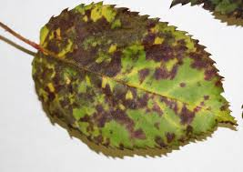

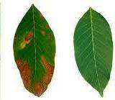
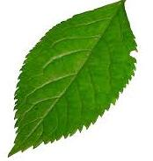
AI in Agriculture using Python
Sample Pictures:

Slide 6
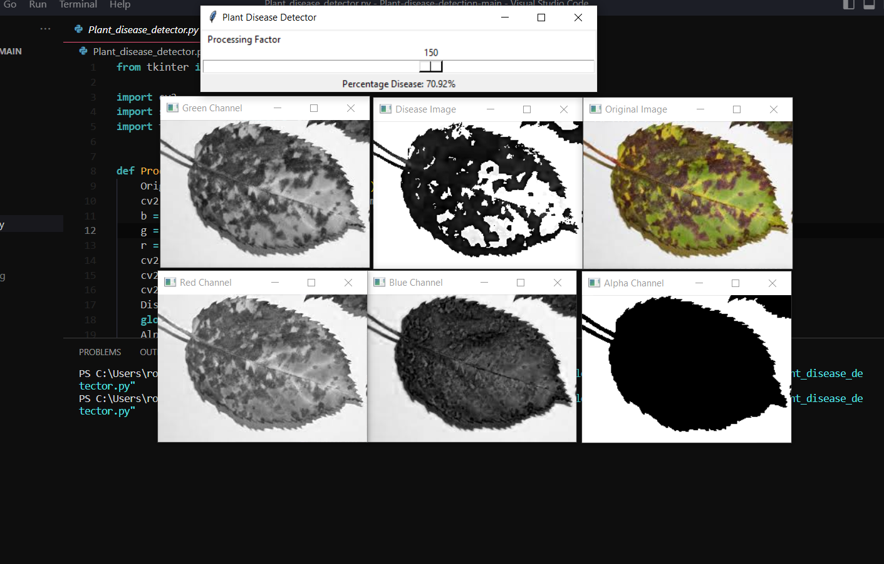
Output Screenshot:

Slide 7
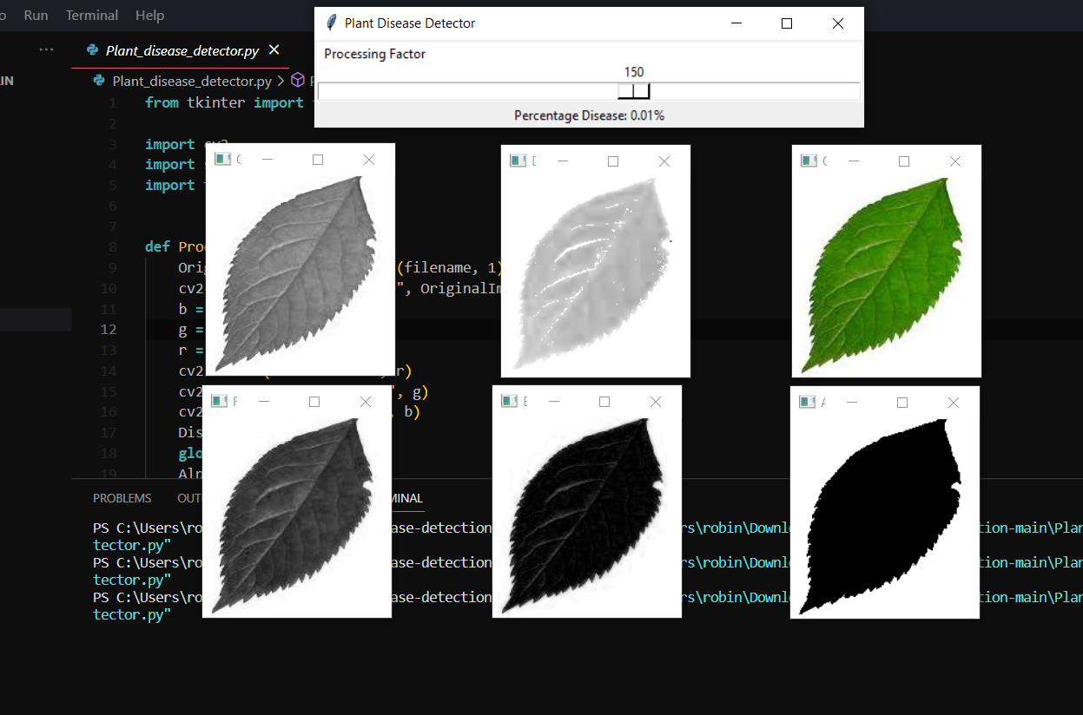

Slide 8
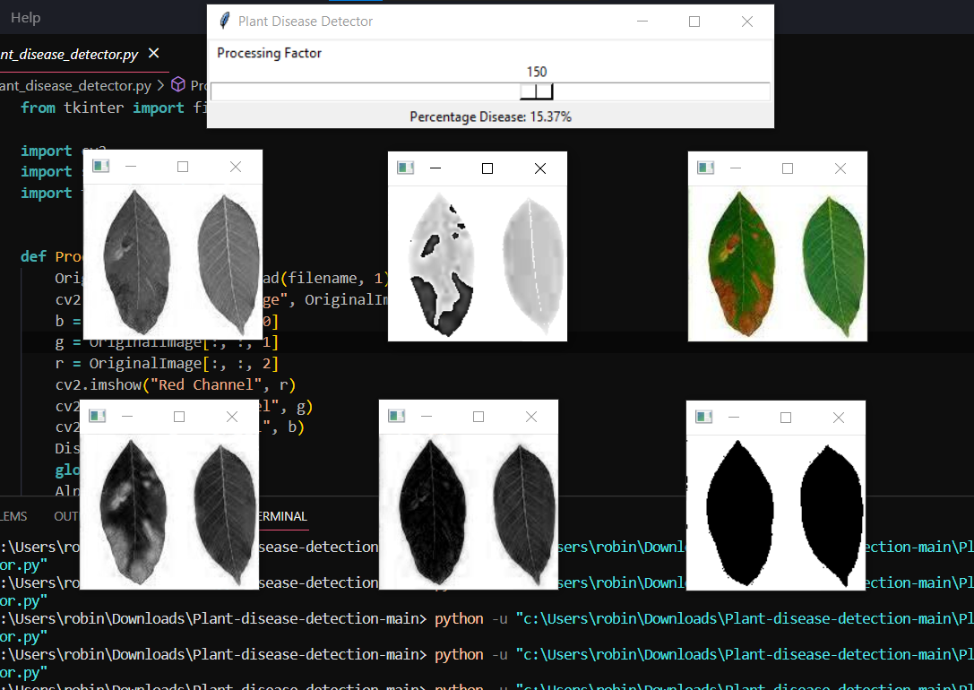

Slide 9
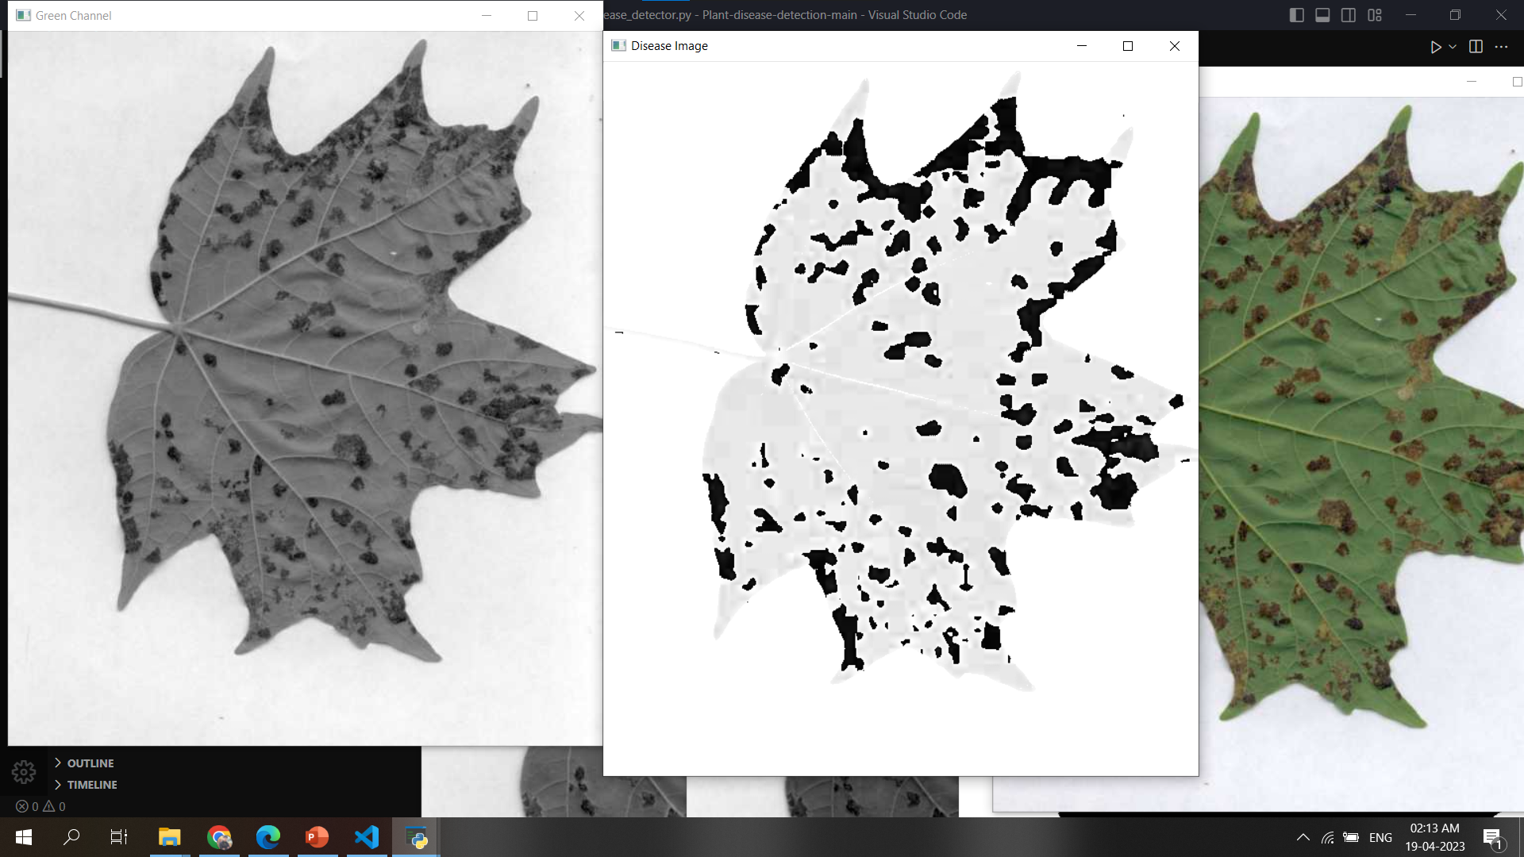

Slide 10
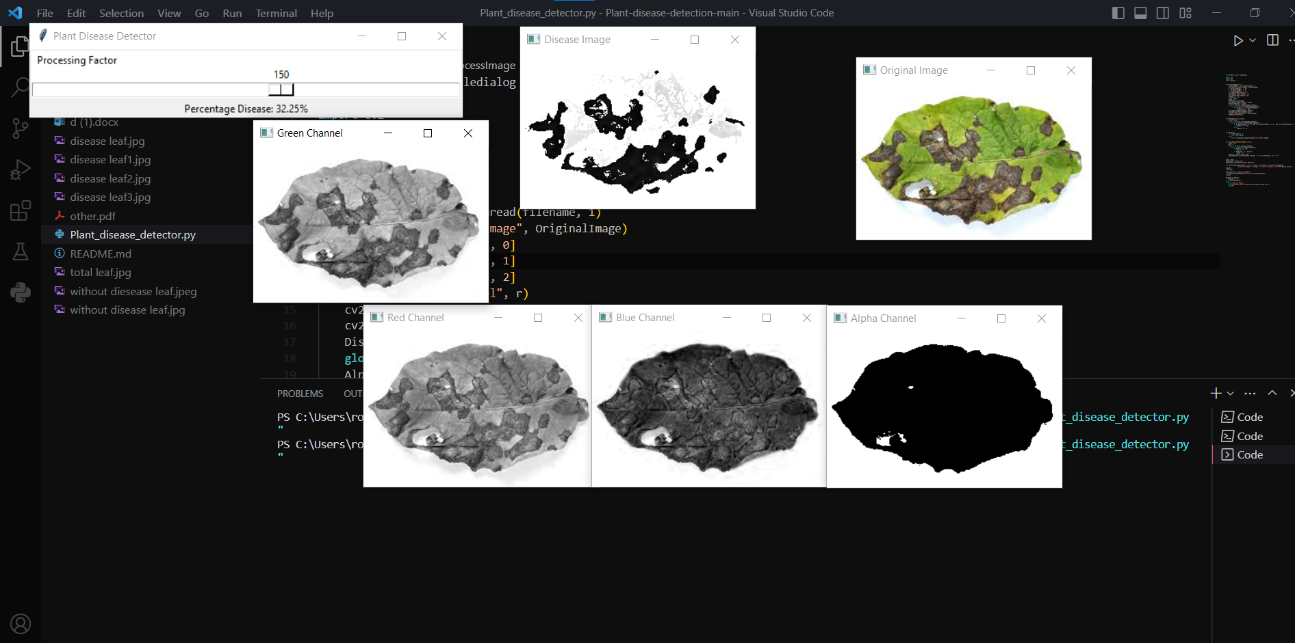

Slide 11
Thank You

